Slide 1
FAIR HOUSING ACT 101 Ashley Richardson Mississippi Center for Justice
Notes:
Hello, my name is ______ and I’m an ______ with the MCJ. The MCJ is a non-profit, public interest law firm that’s committed to the advancement of economic and racial justice for Mississippians.
Pre-Event Questionnaire (google.com)

Slide 2
The work that provided the basis for this publication was supported by funding under a grant with the U.S. Department of Housing and Urban Development. The substance and findings of the work are dedicated to the public. The author and publisher are solely responsible for the accuracy of the statements and interpretations contained in this publication. Such interpretations do not necessarily reflect the views of the Federal Government.
Notes:
We are able to present the presentation to you from a grant provided by HUD. The interpretations are the views of MCJ and not the views of the Federal Government.

Slide 3
WHAT YOU’LL LEARN TODAY
History of the FHA
What fair housing laws are
Who is protected/properties covered
Reasonable Accomodations/Modifications
Unlawful Evictions

Slide 4
Jim Crow Laws→ Civil rights movement
Jim Crow law-state and local laws that enforced racial segregation between the end of Reconstruction in 1877 and the beginning of the civil rights movement.
1963 March on Washington
Civil Rights Act of 1964 prohibited discrimination based on race, religion, color, or national origin in public places, schools, and employment.- No mention of housing.
“Historic prejudice, the belief that property values were more stable in same racial neighborhoods, people should be free to refuse to sell or rent a home to anyone for any reason”

Slide 5
Dr. martin Luther king and fair housing
Around 1965-1967, Dr. King co-led the Chicago Freedom Movement- a campaign that sought to challenge discrimination in employment, education, and housing in Chicago. Under the movement, they advocated for “open housing”- the right for Black Americans to buy homes anywhere they wish.
Testing
“We sent Negroes in large numbers to the real estate offices in Gage Park. Every time Negroes went in, the real estate agent said ‘Oh, I’m sorry we don’t have anything listed.’ And then soon after that we sent some of our fine white staff members into those same real estate offices and the minute those white persons got in, they opened the book. ‘Oh yes, we have several things, now what exactly do you want?’”- Dr. Martin Luther King, Jr.
August 5, 1966- Chicago Freedom March

Slide 6
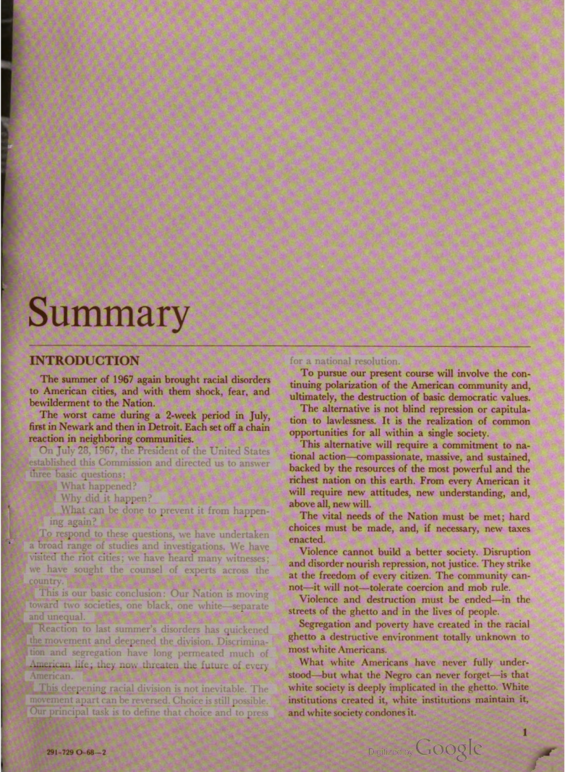
ROAD TO THE Passage of the FAIR HOUSING ACT
Fair housing legislation was introduced before Congress before its passage in 1968
Kerner Commission Report on the causes, events, and aftermaths of the Civil Disorders of 1967 by the National Advisory Commission on Civil Disorders (released in March 1968)
Report that included a detailed history of African Americans in American Society and recommendation for improving the social conditions which foment riots.

Slide 7
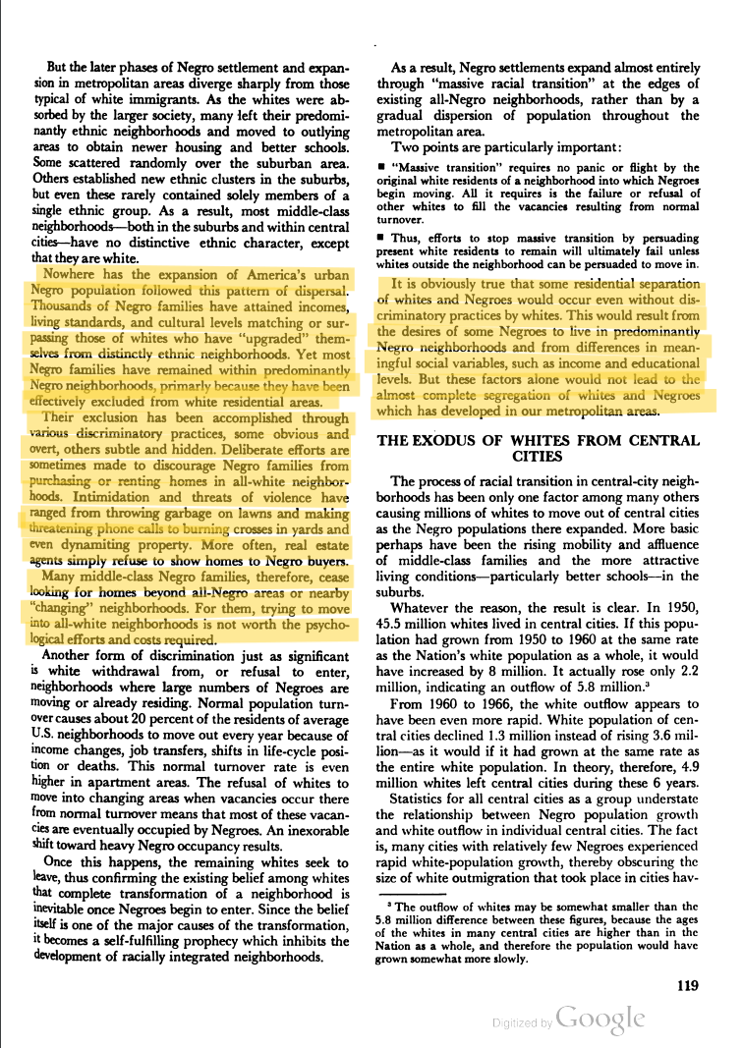

Slide 8
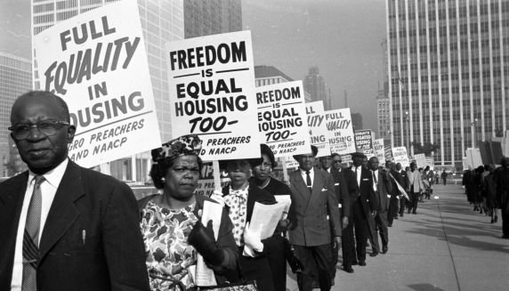
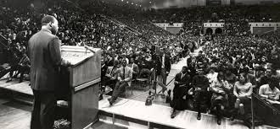
THE FEDERAL FAIR HOUSING ACT
What the Act does
Passed in 1968, after the assassination of Rev. Dr. Martin Luther King, Jr.
Significantly strengthened when it was amended in 1988
Notes:
Just days after the April 1968 assassination of Dr. Martin Luther King, Jr., Congress passed, and the President signed into law, the Federal Fair Housing Act. Shortcut: When it was Passed in 1968, it had 4 protected classes: Race, color, National Origin, and Religion.
Amended in 1974 where it added a protected class: Sex.
Amended again in 1988 as the act we know it as today and it added the last two protected classes: family status and disability.
The FHA has 7 protected classes: Race, color, national origin, disability, family status, religion, and sex. The FHA was created to end housing segregation and to promote inclusion. What this act does is prohibits discrimination in housing on the basis of any of the 7 protected classes.
In 1988, Congress passed an amendment expanding the Act’s coverage. The Fair Housing Act prohibits discrimination in housing based on seven protected class categories: race, color, national origin, religion, sex, familial status, and disability.
Examples of discriminatory behavior under the Act include: refusing to sell, rent or negotiate for housing; setting different terms, conditions or privileges for the sale or rental of a dwelling, for a loan or for homeowner’s insurance; and making housing or housing-related services unavailable. A landlord or builder must make what the Act defines as “reasonable modifications” to structure, and “reasonable accommodations” to rental or condominium policies to allow persons with disabilities to fully enjoy the property. The Act covers most types of housing, as well as “housing-related services,” such as mortgage loans, appraisals and homeowner’s insurance.
Housing-related hate activity, such as cross burning, property damage and harassment, is also covered by the Fair Housing Act. The Fair Housing Act provides legal and administrative recourse for victims of housing discrimination. Consumers may file complaints with the Department of Housing and Urban Development (HUD) or their local human rights commission, or contact a private fair housing organization (of which there are more than 80 across the country).

Slide 9
SEVEN PROTECTED CLASSES
1) Race
2) Disability
3) Family Status
4) National Origin
5) Sex
6) Religion
7) Color
Notes:
Audience participation – ask them if they remember the seven protected classes first before showing them all.
This slide is ordered by number of complaints by protected class:
Race accounts for majority of complaints filed, disability second, and family status with the third highest amount of complaints.
What is the meaning of these terms? Most of them are self-explanatory, but others need some explanation.
Race -- Black/White, African-American/Caucasian, Asian, etc.
Disability
Physical or mental impairment which substantially limits one or more major life activities
Having a record of having such an impairment
Being regarded as having such an impairment
Disability protection covers different treatment, reasonable accommodations and modifications, and accessibility.
Family Status – presence of children in the home
National Origin -- Country of origin of a person or his/her ancestors
Sex – gender-M/F; gender identity and sexual orientation
Religion -- Religious beliefs or membership in a religious group; religious group someone may be apart of or religious beliefs they may have
Color -- Skin tone; degree of pigment in a person’s skin

Slide 10
Religion
Persons of any religious beliefs are covered, as well as people who have no religious beliefs.
Housing providers can decide rather or not to permit decorations or displays by residents in areas around their apartment. If the housing provider permits residents to decorate, the housing provider should not attempt to control the content or the decorations or displays. There can be exceptions.
If a housing provider decorates common areas or the rental office, the general rule is that the decoration should be commercial in nature.
Notes:
A common issue related to religion is a resident’s desire to decorate their apartment door or patio.
Exceptions is if a decoration create a threat to safety, if the decoration is antagonistic, or threatening.
Commercial in nature example: For Christmas-Christmas trees, wreaths, lights. For Easter-easter eggs and bunnies because they are not considered religious decorations but crosses, nativity scenes, and the star of David are examples or religious decorations that could discourage applicants of a different religion.

Slide 11
FAMILIAL STATUS
Protects households that includes one or more children under the age of 18
Pregnant individuals are also protected under this category
Notes:
Family status can include grandparents, foster parents, and parents with partial custody.
Generally, children should not be prohibited from using certain amenities unless there are documented health and safety prohibitions for young children recommended by a third party such as a manufacturer.
For most amenities, children should be permitted access, and housing providers can adopt reasonable supervision rules for children using amenities such as swimming pools that create obvious safety hazards for unsupervised children. “Reasonable” means that the rules should make practical sense rather than being excessively restrictive and not be used to require direct supervision of older children.

Slide 12
SEX
Sex can include gender- male or female.
Definition of sex was expanded by the Supreme Court to include sexual orientation and gender identity.
Protection of this class applies even with a housing provider’s perception of a person’s sexual orientation or gender identity is incorrect.
Notes:
Example: A gay man who currently uses a voucher to pay his rent contacts the property owner to request to add his male partner, who is also income-eligible, to the lease so they could live together. The owner asks, “Are you gay?” and denies the request when the tenant confirms that he is gay.

Slide 13
Transactions Covered
Residential home sales and rentals
Homeowners Insurance- Discrimination in homeowners insurance occurs when an insurance company or agent unlawfully treats current or prospective homeowners differently because of one of the seven protected classes
Denial of Reasonable Accommodations
Denial of Reasonable Modifications
Mortgage Loans- any stage of the mortgage process- approvals/denials, property appraisals, terms (interest rates, fees, etc)
Realtors
Landlords
Newspapers and ads- Generally, a housing advertisement should describe the property itself, and not the potential occupant
All Areas Connected with Residential Housing
Notes:
These are some basic transactions that are covered by the Fair Housing Act. (There are more provided throughout the presentation.)
Virtually all housing-related transactions are covered by the Fair Housing Act.
All residential home sales and rentals.
All services and facilities related to housing – like community rooms, swimming pools, common areas
Stating whether housing is actually available.
If one person is told that an apartment is available and another is told not available because of the fact that that person is a member of a protected class, that is illegal.
Discrimination in homeowners insurance can include charging higher rates, offering policies with inferior coverage, not returning calls for information, denying coverage altogether.

Slide 14
HOUSING COVERED
Apartments, houses, houseboats, homeless shelters, and migrant farmworker housing.
Any residential building or vacant land available sale or lease
Any place to which a person “intends to return.”
Notes:
Housing in the Fair Housing Act is often referred to as “dwellings”. Dwellings covered include:
Any residential building or vacant land intended for residence – available for sale or lease
Apartments, houseboats, homeless shelters, migrant farmworker housing
Any place to which a person “intends to return.”
There are other places where people stay too – hotels, campgrounds, etc. These are not considered “dwellings” – but they would be considered public accommodations.
protected by civil rights commissions and those complaints should be filed with them.
Other places fall in between – timeshares, homeless shelters. The key is whether it is a place to which a person “intends to return” Timeshares and homeless shelters have both been considered “dwellings” in different cases.

Slide 15
ACTIONS THAT CAN VIOLATE THE LAW

Slide 16
TREATMENT v. IMPACT
Differential treatment: Treating someone differently because of race, color, religion, sex, national origin, disability or because they have children.
For example, charging people of color a higher rent or deposit for the same unit rent or refusing to allow children access to the pool or community room.
Disparate Impact: Facially neutral policy that has a disparate impact on a protected class.
Policy of one heart beat per bedroom / Zoning
Notes:
Differential treatment-intentional discrimination; someone of a certain race can’t stay here
Disparate impact- the law or policy as read treats everyone the same but its enforced in a way that’s discriminatory to a particular group. Ex: One heart beat per bedroom policy. On the face it seems to be a neutral policy that treats everyone the same but in practice, it discriminates against families. Ex: A family of 5 or 6 would like to buy a 2 or 3 bedroom home. Under this policy, the family wouldn’t be able to rent from this property and it would limit housing choices for families with children. As we learned earlier, family status is a protected class under the act.

Slide 17
Discriminate in Terms or Conditions
Using different provisions in leases or contracts;
Failing or delaying maintenance or repairs;
Limiting use of privileges, services, facilities of an owner, tenant or a person associated with him or her.
Assigning certain applicants to particular areas of the complex

Slide 18
Steering
Vacancy Unavailability
Example 1: A white prospective renter states or writes on a guest form that they are looking for a two bedroom 1 bath apartment. The leasing consultant takes them to see apartment 35. The same day, another prospective tenant, black, comes by and says that they are seeking to rent a two bedroom 1 bath apartment. The leasing consultant takes this prospective tenant to see apartment 108, which also happens to be a two bedroom 1 bath apartment. Is this a problem?
Example 2: A prospective woman tenant comes to your complex on Tuesday searching for a two bedroom 1 bath apartment for her and her children. The leasing consultant tells the prospective tenant that two bedroom units were unavailable for the next couple of months. Days later, another prospective tenant (male) comes to your complex searching for a two bedroom 1 bath apartment in which he plans to live alone. The leasing consultant again looks through the paperwork, but she now sees that there will be a two bedroom available in three weeks. The leasing consultant realizes that she made a mistake earlier during the week when she told the first prospective tenant that there was no availability. Could this be a violation?
Example 3: An older black couple visits your complex and says they would like to rent a 2 bedroom apartment as they are moving in the area and want to spend more time with their grandchildren. The leasing consultant truthfully tells the couple that there is no vacancy, but will notify them where there is a vacancy. The next day, another prospective tenant comes to your complex searching for a two bedroom home. She is a white single mother and appears to be pregnant. Earlier the same day, one of the tenants in the building informed the leasing consultant that they plan to move out within a couple of weeks. The leasing consultant tells the woman that although a unit became available today, there is another prospective tenant interested in the home who she promised she would notify once something comes open. She states she first have to reach out to them to see if they are still interested. If they are not interested, and if they are not interested, she will reach back out to her. Could this be a violation?
Notes:
It is illegal for a housing provider to steer a prospect due to their protected category to a particular apartment, particular area within the apartment community, or to a different community. This is called steering. An example of this might be having African Americans or Hispanics live in a certain building or section of a property. Most common practices of steering is: encouraging applicants who speak a language other than English to live in a certain area of the property, discouraging families with children from living on upper floors, suggesting wheelchair users live on lower floors, if the complex has a playground encouraging families with young children to live close to the playground, etc.
The best way to avoid illegal steering is to permit a prospect to decide the best place for them to live.
Answer to question 1: It depends of whether there’s a good reason for showing two different prospects two different apartments although their request was the same. Maybe one might have written on a guest card that they would like an apartment close to the pool and this could help explain why they were shown a different model apartment. Recording and documenting information like this to help for possible claims of discrimination. If you do choose to go this route, guest information should be consistently used, thoroughly completed, and keep this information for a certain amount of time.
The policy can be that an apartment that has been vacant the longest will be shown and offered or that prospects are shown and offered all vacancies. Whatever the policy is, it should be consistent.
Steering can be an issue-To avoid this, housing providers should have a documented reason why they chose a particular vacancy to show or discuss with a prospect. If your complex have prospective applicants completing a guest information card, this should be used to explain the choice of apartments shown. Another option is that the apartment can have a policy of the order in which apartments should be shown or offered for lease.
Answer to question 2-possibly, even with there being a mistake. The first prospective tenant can allege discrimination based off of sex and even family status as she stated the apartment would be for her and her children.
Answer to example 3 under vacancy unavailability: Maybe the woman will allege discrimination based on race or family status. Maybe. But, if this is the policy of the complex, and it is followed for all prospects with the callback system when something becomes available, or even something such as putting people on a waiting list, the complex has a stronger defense.
Just to be clear, private markets are not required to have these type of policies in place like the callback system or waiting lists. But, if they do have these policies in place, it must be consistent, should be accurate, and have up-to-date availability information to protect you from any potential violations.

Slide 19
Marketing
Advertising and marketing refers to how a housing provider sells the property to the public.
Marketing can be verbal statements, written information, or electronic information. With marketing and advertising, a bias might be shown against a person due to their protected category.
Notes:
Verbal statements can be considered marketing so this can affect everyone who works on the property.
Advertising can include a property’s website, newspaper ads, social media ads, billboards, brochures, newsletters, signs, emails, and any other means used to promote the property to the community or its residents.

Slide 20
Notes:
Audience Participation: Here is an example of an advertisement for a community. Is there anything on the flyer/brochure that someone could possibly consider as discriminatory advertising?
Scripture at the top of the flyer. Religious scriptures or symbols should be avoided in advertising. Even if it is a nice or encouraging scripture, it could discourage residents who don’t identify with that religion.
There is possibly nothing wrong with the name of the apartment complex “St. Mark’s Apartments”. While most people may associate the name saint with Christianity, there is nothing discriminatory about the name itself. As long as it is clear that the complex welcome people of all or no religious beliefs, the name can be seen as fine.
Picture of white residents- Looks as just neighbors of a family enjoying the community. But, if you notice, all of the people in the picture are white. This could discourage any potential non-white applicants from applying. Each individual picture on a brochure of flyer doesn’t have to include everyone, a marketing plan in general should include pictures of persons that are obviously from several protected categories to ensure everyone will feel welcome.
“Enjoy quiet living at its finest”- Most people would probably enjoy a quiet and peaceful community, but this type of phrase you in advertising could possibly be seen as discriminatory against families with children.
“Private community”- Most properties use gated community and there is nothing discriminatory with using either phrase

Slide 21
Notes:
This may be seen as an acceptable picture that includes people from different protected categories.

Slide 22
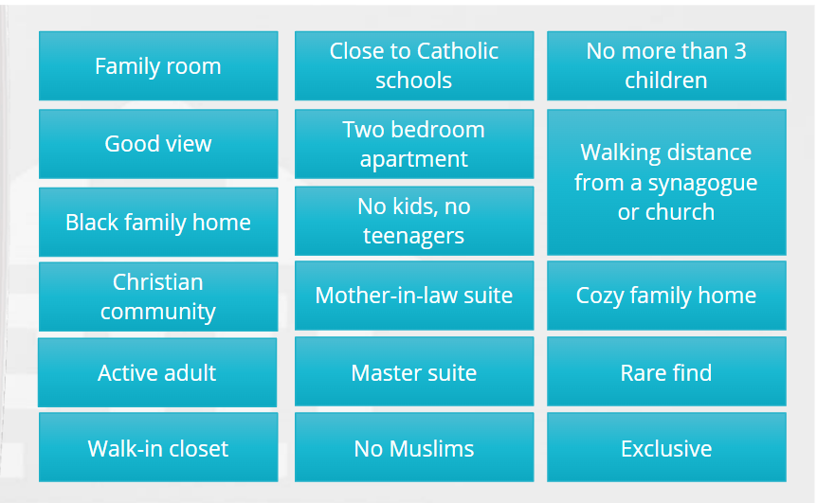
Advertising
Notes:
Audience participation: Your apartment complex would like to advertise your community and plans to make a brochure. Let’s decide out of these options which terms may be discriminatory and which terms may not be discriminatory.

Slide 23
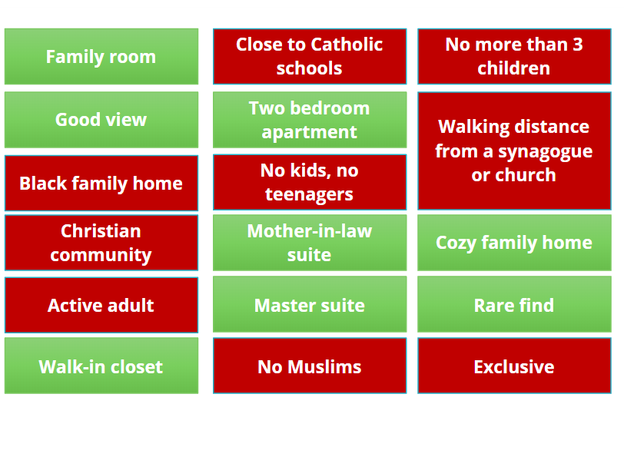
Notes:
Green is acceptable terms and red may be considered discriminatory terms
“active adult” can be words indicative of handicap
“exclusive” this is a catch word or phrase that can be used in a discriminatory context; this is the same as saying private, restricted, traditional, etc

Slide 24
Refuse to Rent or Negotiate
Failing to accept or consider a bonafide offer;
Refusing to sell or rent or negotiate for sale or rental;
Using different qualifications criteria or applications, standards, procedures; and
Evicting tenants because of race, etc...or because of the race of tenant’s guest.
Negotiating rent prices
Notes:
Bonafide-honest, genuine, acting without intent to defraud. Ex: offering to buy a mansion for $10. Not a bonafide offer. (Unless that’s what their asking for)
Evicting ex: White family staying in a property but have black friends come over and visit all the time. Can’t be evicted because of the
Using different qualifications criteria-Discriminatory conditions such as charging “extra” rent or security deposits due to a household having children, a resident uses a wheelchair, or that reasonable modifications need to be made to the home. We will talk about reasonable modifications and accomodations later in this presentation but provisions may need to be adjusted due to a resident’s disability.
Some companies let their leasing consultatants negotiate with applicants rent prices. With this, the company should be sure that there isn’t intentional or unintentional differences in treatment with this practice. With this practice, it could leave to possible claims arguing there was a difference in the resulting rents that’s associated with the applicant’s protected categories such as it showing on average Black applicants paid so much more through negotiations vs white applicants for rent.

Slide 25
Untruthful Information
Indicating through words or conduct that a unit which is available for inspection, sale or rental has been sold or rented because of any of the protected classes.
Limiting information by word or conduct regarding suitably priced dwellings available for inspection.
Manager only quotes highest priced apartments as available.

Slide 26
HARASSMENT IN HOUSING IS ILLEGAL
This includes:
Sexual harassment
Racial harassment
Hostile harassment
Coercion, intimidation, and retaliation
This includes harrassment by employees of housing provider and even other residents or neighbors
Notes:
Can be held liable for the actions of residents for failrue to take prompt action to correct or end discriminatory conduct by an employee, agent, third party where higher ups knew or should have known (direct liability).
This can include harassment by employees of the housing provider and even other residents or neighbors.
Housing providers should address any allegations of sexual harassment with prompt and effective actions, including thorough investigations, and a written determination of whether adequate evidence was found during the investigation to substantiate the claim.
Employees should be trained regularly on the kind of actions and statements that might risk a sexual harassment claim.
Hostile harassment- harassment so severe that it interferes with a person’s ability to access and live in their home
Sexual harassment
by physical conduct or through words
by property employees or residents
trade-off proposed, or the harassment is so pervasive that it becomes a term or condition of housing
Milestone fair housing case sexual harassment is 1983 Shellhammer vs. Lewallen -- Shellhammers evicted because Mrs. Shellhammer rejected Lewallen’s sexual advances.
Significance
The case applied Title 7 to the FHA– the equal opportunity statute in employment which includes sexual harassment
Sexual harassment under Title 7 includes “sexual consideration in exchange for job benefits” and “creating an offensive environment” can also apply to housing.
Racial harassment -- “an interference with the right to live free from discrimination in housing.”
Case: Filed with the HOPE Fair Housing Center in Chicago.
A black police officer went with her co-worker (African American man) and her real estate agent (African American woman) to look at a house. the white male neighbor came over and yelled epithets at her and said that she’d better watch out that the house never caught fire because it would definitely burn down. It turned out the neighbor was a firefighter. All three -- the two officers and the agent – sued and won.
Coercion
It is unlawful for any person to coerce, intimidate, threaten or interfere with any person in the exercise or enjoyment of, or on account of his having exercised or enjoyed any right under the law or because the person has aided or encouraged any person in the exercise of his rights.
An interesting note: If someone files a housing complaint and the respondent retaliates somehow, then the respondent would be charged double damages.

Slide 27
Violence Against Women Act (VAWA)

Slide 28
VAWA
A federal law that, in part, provides housing protections for people applying for or living in units subsidized by the federal government and who have experienced domestic violence, dating violence, sexual assault, or stalking, to help keep them safe and reduce their likelihood of experiencing homelessness.
The survivor does NOT have to be married to, related to, or living with the perpetrator to be protected by VAWA. It does not matter how long ago the survivor experienced the violence. A survivor’s immigration status in itself does not impact a survivor’s right to VAWA’s housing protections.
VAWA protects survivors, regardless of their sex, gender identity, or sexual orientation AND regardless of the sex, gender identity or sexual orientation of the person who caused harm.

Slide 29
FAIR HOUSING AND MAINTENANCE EMPLOYEES
Notes:
Yes. The Fair Housing Act applies to maintenance employees also. Earlier in the slide, we made it easy for maintenance employees by telling them to direct potential applicants to leasing office. But truthfully, maintenance employees have direct contact with residents of complex and their actions could also possibly violate the law from their actions or statements.

Slide 30
What can you do?
Example: A maintenance employee, Tyrone, has been working at an apartment complex for 5 years and has built some friendships with many of the residents. It is stated in the lease of the apartment complex that the residents are required to change the batteries in their smoke detectors every 6 months. Tyrone has built a relationship with one particular resident, Ashley, and he knows that she can be forgetful about switching her battery out. He puts a reminder in his phone to buy and switch her battery out for her twice a year. Is this a problem?
Establish a policy describing the order in which all work orders are performed.
Have a policy in place pertaining to maintenance employees
Notes:
During some fair housing investigations, housing providers can be required to submit work order documentation for the past year or two. There have been instances of housing providers who wanted a resident to leave due to a protected category so they would delay or avoid providing maintenance service to the resident altogether. Because of this, investigators may request maintenance records.
The work orders should contain the date the order was made and completed.
If a work order has to be delayed due to maybe a back-ordered part, appropriate staff should inform the resident and document the reason for the delay on the work order. Maintain these records for a certain period, including atleast 3 years after the resident moves.
Second bullet point- As stated earlier, maintenance employees can be very hands on with tenants and can have frequent interactions so this could possibly lead to a number of issues related to unfair and unequal treatment.
Some ways that the complex and employees can be safe is 1) if an employee encounters an undressed or inappropriately dressed resident in their apartment, the employee should immediately leave and document the incident. 2) An employee should not enter an apartment occupies only by a child, even with the parents’ permission. If immediate entry is critical, more than one employee should be present. 3) All incidents between an employee and resident should be documented if the situation involved something that could come back against the employee or property later. 4) Employees should be warned against participating in a romantic or sexual relationship with a resident.
Answer to example: Morally, Tyrone didn’t do anything wrong and it is usual to favor some residents over others, but he may have from a Fair Housing view. Although Tyrone and Ashley have built a friendship, maintenance employees should avoid doing “favors” for favorite residents. It could become a violation where they would do something for one resident but not for another. So with this, it would be safe to avoid the appearance of favoritism or the appearance of predatory treatment. (go to bullet 3)

Slide 31
DISCRIMINATION BASED ON DISABILITY
Notes:
What does disability mean? -- who remembers??
As we discussed earlier, a disability can be a mental or a physical disability, or the perception of such.
It can be past substance abuse but the law does not protect against current substance abuse.
We mentioned it accounts for the second largest number of complaints that our members receive.
It includes:
Refusing to sell or rent based on disability -- or anything related to that including not disclosing availability, unwillingness to discuss terms.
It can be based on :
the disability of buyer or renter
the disability of another person residing in or intending to reside in the dwelling
the association with a person with a disability
One call file a FH Complaint for treating an indivdial differently due to that person or anyone associated with that person’s disability, failure to provide a reasonable accommodation or modification, and accessibility

Slide 32
THREE WAYS ONE CAN HAVE A DISABILITY
A physical or mental handicap that substantially limits one or more life activities, like walking, talking, breathing, hearing, seeing, driving, and other daily activities.
Having a history of such an impairment.
Being perceived as having such an impairment.
Notes:
It is illegal to discriminate against a person with a disability. It is required that applicants and residents with disabilities receive special consideration.
One does not have to receive a disability check from the government or work in order to be considered disabled under the Act. FHA was passed to end housing segregation and to promote inclusion so under the act, everyone should be treated the same EXCEPT when it comes to disability. When it comes to disability, the person should be treated differently b/c they have to be provided a different treatment in order to have equal and full enjoyment of the premises.
People who associate with persons with disabilities are also protected from housing discrimination.

Slide 33
REASONABLE ACCOMMODATION
A change in rule, policy, or procedure necessary to allow a person with a disability to fully utilize their housing.
The housing provider is required to pay for this change, although there may be no actual cost.
Examples include: Change in due date of rent; Reserved Handicap Parking; Service/Assitive animial; Transfer to ground floor unit.
Notes:
A reasonable accommodation is NOT the housing provider giving residents and applicants with disabilities they want. Instead, it is to provide disabled residents and applicants with the accommodations that are both reasonable and necessary UNLESS doing so would create an undue administrative and financial burden.

Slide 34
When Do Accommodations
Have to Be Made?
•The requested accommodation(s) must be made if it is reasonable.
•The requested accommodation(s) must be acted upon within a reasonable time, because delay may amount to a denial of the accommodation.
•There must be a connection between the reasonable accommodation and the disability.
Notes:
Unreasonable ex: tenant physically unable to open the dumpster placed in the parking lot by the housing provider…..
(If asked) To determine if it’s reasonable determine 1) if it would impose an undue financial and administrative burden on the housing provider and 2) would it fundamentally alter the nature of the housing provider’s program.
If an undue burden or fundamental alteration exists, housing provider is still required to provide any other reasonable accommodation up to the point that would not result in an undue financial and administrative burden on the housing provider or constitute a fundamental alteration of the program.

Slide 35
It is on the resident to make the request for a specific accommodation.
You can clarify whether a resident is making a request because of a disability or merely requesting it for their convenience.
You are not required to permit persons with disabilities to ignore your rules and procedures.
Notes:
Although it’s on the resident to make a accommodation request, please understand that this may not be necessarily called a “reasonable accommodation” request by the resident. They may not even say the words reasonable accommodation. Either way, it should be noted and treated like such. Also, please be aware that some residents may not even know about the FHA. So in some unique situations, you may have to offer an accommodation before it’s requested.
2) WE’RE NOT SAYING TO ASK IF THE PERSON HAS A DISABILITY OR TO PONDER ABOUT THE NATURE OR SEVERITY OF A DISABILITY. Ex: An applicant may ask a LC to waive their history of poor credit because they recently spent time in a hospital. Their hospital stay may or may not be related to a disability. The LC may ask “are you requesting that I make an exception to our usual screening criteria because of a disability?” The LC didn’t ask if the person has a disability, the nature or severity. The applicant can answer yes and the LC can then began the reasonable accommodation request process.
3) You must consider any and all requests for reasonable accommodations, you are not required to permit persons with disabilities to ignore your rules and procedures. An example could be a resident disturbing their neighbors with cursing and shouting etc due to a mental disability with paranoia. When the staff gives this resident a termination notice due to the behavior, the resident will more than likely ask for another chance to correct this behavior if it is caused by their mental disability. The housing provider should consider the request, consider the disability-related need of the resident, and should consider granting the request for an extra chance.

Slide 36
When the disability is not readily apparent/obvious
If a resident requests a reasonable accommodation, and if the disability status and need for the accommodation is not readily apparent or obvious to the housing provider, the housing provider is permitted to obtain 3rd party verification that the resident is disabled and that the accommodation is directly related to the resident’s disability.
If the resident or medical provider provides you with medical records, you should return those to the resident and ask the verifier to answer the specific questions you are permitted to ask.
Housing providers can request the use of their forms for reasonable accommodations. If a resident and verifier provide the information in a different format, housing providers cannot refuse to process a request because the resident didn’t use its particular forms.
Notes:
f a person’s disability is obvious, readily apparent, or otherwise known to the provider, and if the need for the requested accommodation or modification is also readily apparent or known, then the provider may not request any additional information. If the disability and/or the disability-related need for the requested accommodation or modification is not known or obvious, the provider may request only information that is necessary to evaluate the disability and/or disability-related need for the accommodation.
(1st bullet point)-We are not saying to ask for medical records from the applicant/resident!!!! (reiterate this). You should make this clear to the resident that you ARE NOT asking for medical records, but instead a verification.
Example: If a resident contacts a property manager to request an assigned parking space due to a mobility impairment, and brings with her a letter from her doctor that explain that the resident is disabled, is unable to walk more than 50 feet without stopping, and needs a parking space close to the resident’s apartment entry, the housing provider should not reject the resident’s request and insist that only requests and verifications on their forms will be accepted. The manager could fill out the request form so the request is documented in the file, and if the doctor’s letter provides the information needed such as the answers to the two primary questions (which are 1) is the resident disabled and 2) how the request is connected to the disability)), the housing provider should accept the letter and move forward with the request. If the letter don’t answer these questions, you can follow up by sending the verification form and authorization by the resident.
The purpose of verification is to document the need of the resident for the requested accommodation. YOU SHOULD NOT REQUIRE OR EXPECT THAT ALL VERIFIERS WILL BE MEDICAL DOCTORS. IT’S NOT ALWAYS A GOOD PRACTICE TO INSIST A RESIDENT BRING A “DOCTOR’S NOTE” TO JUSTIFY A REASONABLE ACCOMMODATION. A verifier can be someone identified by the resident who is objective and has adequate knowledge of the resident to be able to state that the resident is disabled, and how the requested accommodation is related to the disability. THE MOST COMMON VERIFIERS ARE MEDICAL OR MENTAL HEALTH PROFESSIONALS, AND YOU CAN REFUSE A VERIFIER WHO IS NOT OBJECTIVE OR RELIABLE, YOU SHOULD NOT RESTRICT VERIFIERS TO ONLY MEDICAL PROVIDERS. (ex: licensed social worker who might know about their disability, peer support group, a non-medical service agency, or any other reliable 3rd party who is in a position to know about the resident’s disability).

Slide 37
Example: A leasing consultant (“LC”) has three tenants come in within three days with similar situations. The first tenant, a white man, comes in to sign a lease and say that they have a small puppy to add to the lease. The LC informed the tenant about the pet deposit, and the tenant paid the deposit. The second tenant, a white woman, comes into the office to tell the LC that her boyfriend bought her a dog, a Great Dane. The LC informs the tenant that there’s a 50 lb limit on pets as policy, so unfortunately, her new dog would not be allowed to stay on the property. A third tenant, a black man, goes to the LC with a doctors note saying that they need an assistance animal due to their disability. The assistance animal is a German Shepherd. The LC documents this and did not ask the third tenant for a pet deposit.
Notes:
We have three different closely related scenarios here where the LC gave a different outcome. Was the LC correct to handle these situations this way in her inconsistency? (Yes).
Rules of the complex should be detailed in the lease and house rules (we sometimes see addendums in leases with these rules). For example, there may be a pet deposit, a limit on the number, type, or size of pets that a resident can have. These policies should be consistently enforced with all residents. The EXCEPTION is when a resident makes a reasonable accommodation request. When a resident makes a reasonable accommodation request, the FHA requires the housing provider to consider granting the request if the resident is disabled and if the accommodation is necessary for the resident to be comfortable living on the property. RA requests should be evaluated on a case-by-case basis.

Slide 38
ASSISTANCE ANIMALS
Most common type of Reasonable Accommodation request is for assistance animals.
An assistance animal (service animal or emotional support animal) is an animal that works, provides assistance, or perform tasks for the benefit of a person with a disability, or that provides emotional support that alleviates one or more identified effects of a person’s disability.
An assistance animal is not to be considered a pet.
Notes:
Rule-No pets; or there may be limitations to number, type of animal, size, breed. Or even charge a pet deposit. When there’s a RA, they are making an exception to the no pet policy or they are not being limited to usual pet requirements, and excusing the pet security deposit or pet rents.
Assistance animals includes service and emotional support animals. Rather the animal is a service or emotional support animal, the reasonable accommodation process is the same

Slide 39
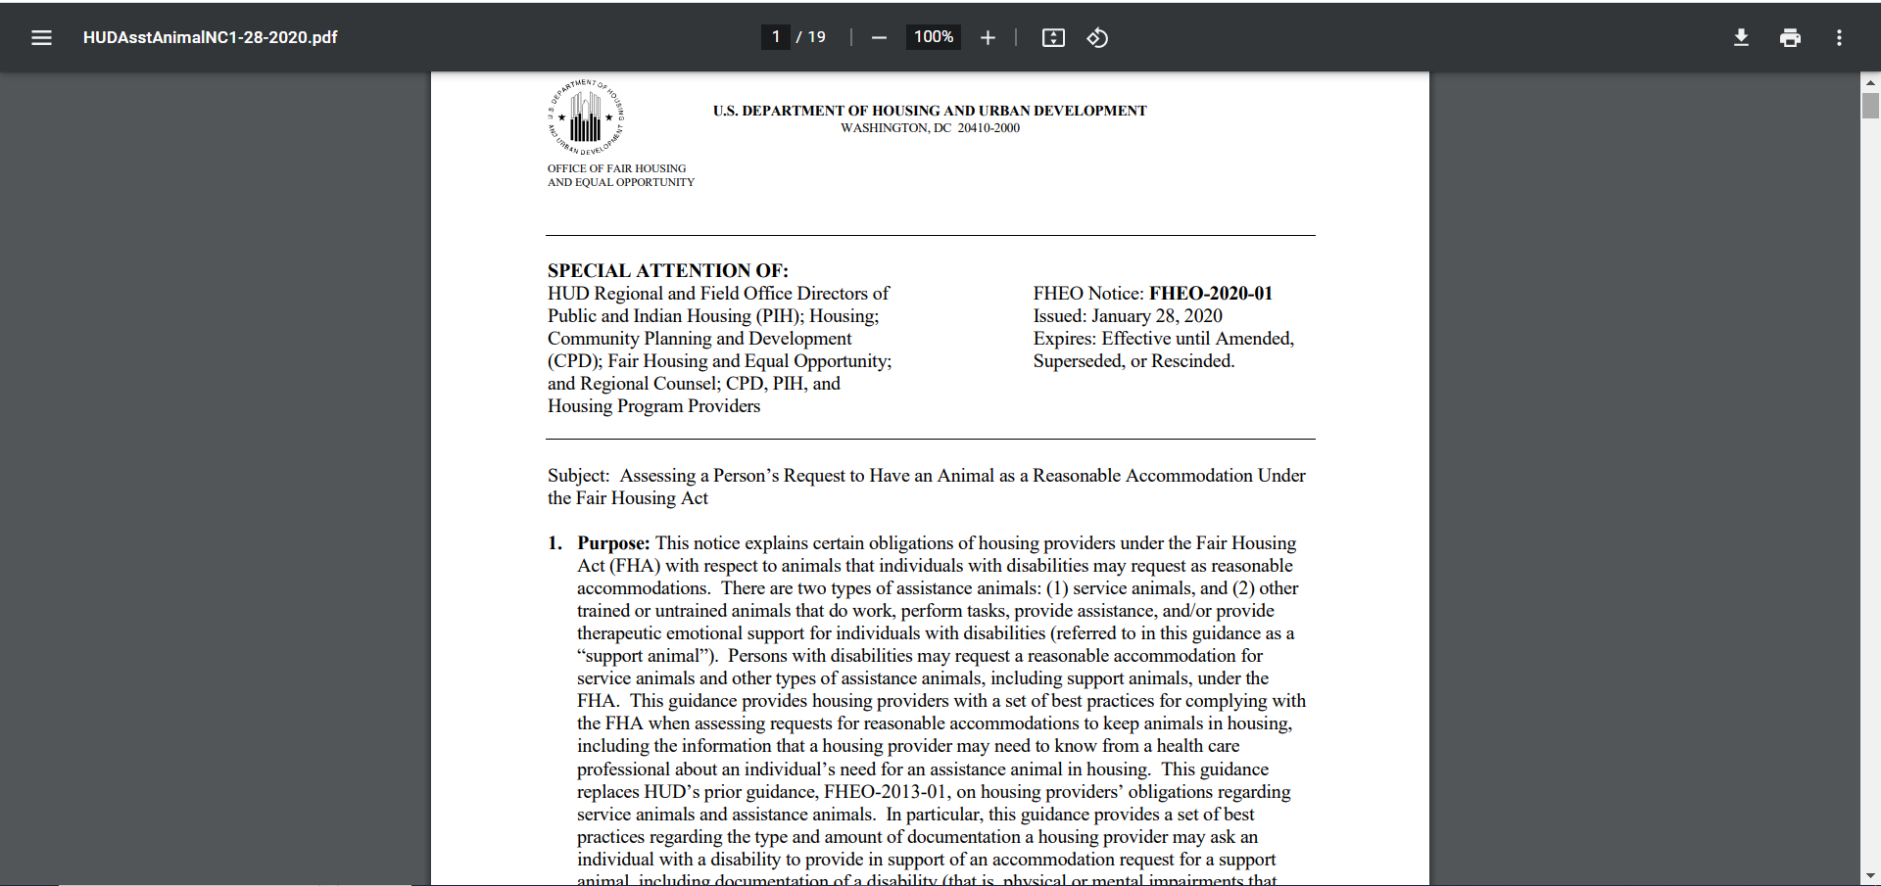
ASSISTANCE ANIMALS
Service Animal
An animal specifically trained to provide service to a disabled person
They are most commonly used by residents with physical disabilities
Emotional Support Animal
a/k/a therapy or support animal
Most commonly used by residents with mental disabilities
Notes:
Just learned that an assistance animal includes both a service animal and emotional support animal.
https://www.hud.gov/sites/dfiles/PA/documents/HUDAsstAnimalNC1-28-2020.pdf
Can help you determine questions you can and can’t ask, what documentation you can request through a step by step basis.

Slide 40
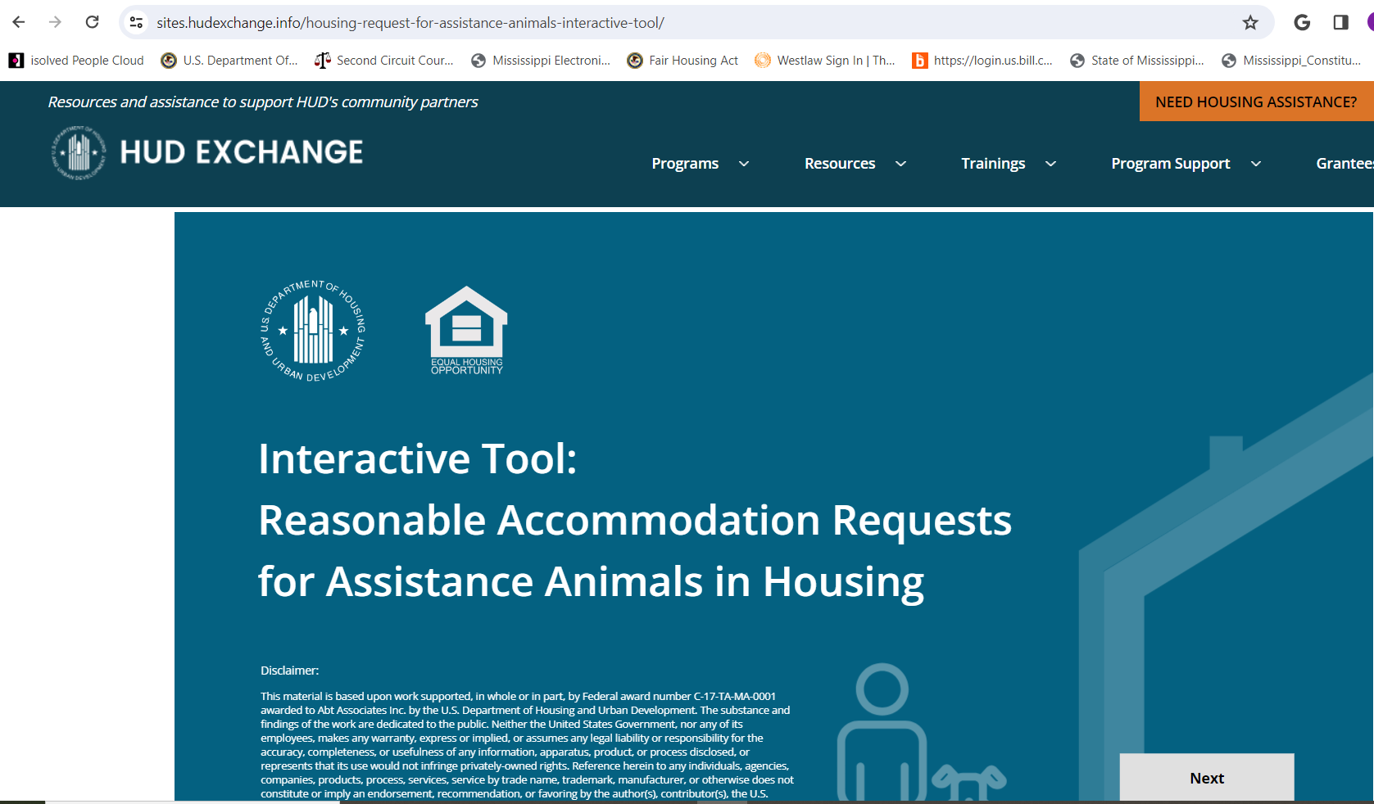
Interactive Tool from HUD

Slide 41
What is the difference between an Emotional Support Animal and a Pet?
Emotional Support Animal
Pet
Resident has a disability-related need for the animal
Resident an provide verification that they are disabled
Because of that disability, the Resident needs the companionship and therapeutic benefits provided by the animal
Notes:
Simply put, there are no differences between how a pet and an ESA looks or behaves. An ESA may used to have been a pet that has now turned into a ESA.

Slide 42
Another most common type of Reasonable Accommodation is a request for a transfer to a different apartment due to their disability before the end of their lease.
Notes:
Of course, most housing providers would automatically permit a resident to change apartments at the end of their lease. But if the request occurs mid-lease, there may be more concern about permitting the transfer and also about associated fees. The question is, as with any exception, is whether the resident is disabled and whether it is the disability that’s motivating the request (is it connected).
Example: Let’s say a resident with an apartment on the 2nd floor has developed an obvious mobility problem that makes him hard for her to climb the stairs. The resident requests to transfer to a first floor unit. As soon as a first floor unit becomes available, the resident should be transferred.
The transfer should not wait for the end of the lease term and in many instances, it is probably reasonable to waive any associated fees. Also, because the need of the resident for the transfer is obvious, verification isn’t needed.

Slide 43
The law protects the rights of residents with disabilities from having to disclose unnecessary and confidential details about their disability to housing providers.
You cannot ask about the nature or severity of a person’s disability and you also cannot ask how long the resident has had the disability, UNLESS you are trying to determine whether the disability is temporary.
A resident who uses assistance aids, such as wheelchairs or animals, cannot be excluded from housing because they use these and other types of aids that may be necessary for them to be able to fully use and benefit from their housing communities.
You cannot apply different terms or conditions for a disabled person from those of a non-disabled person, if the difference is based on disability. You also cannot charge a higher security deposit to a person that uses a wheelchair because he may damage the carpeting or flooring in an apartment.
A resident can arrange for outside services to take care of essential household and personal tasks. A housing provider cannot insist that, to be eligible for an apartment, a resident be able to perform personal care tasks or lease requirements without assistance.
Notes:
1) Residents are not required to disclose details about their disabilities

Slide 44
REASONABLE MODIFICATIONS
A structural change in the property to allow a person with a disability to fully utilize their housing.
Examples:
Slap door handles.
Light switches, electrical outlets, shower bars, thermostats, and AC placed at the proper height.
Notes:
A reasonable modification or accommodation can be requested by the tenant at any time. It doesn’t have to be requested at move-in.
The process a housing provider follows when a resident makes a request for a reasonable modificationis identical to a reasonable accommodation request. They should be asked to fill out a RM request form. If the disability status and/or the need for the request is not readily apparent or observable, the housin provider can request the resident to identify a verifier and authorize a verification form. The need for many requests for RM are obvious and do not require verification. If the request is approved, it depends on rather the housing provider is private market/conventional or federally funded.

Slide 45
Who has to pay for a Reasonable Modification?
General rule is that in private market housing, the costs are the responsibility of the resident.
For federally funded properties, in most instances the housing provider will process the request, and if granted, will make the modification and pay for it.
Notes:
This does not prevent a housing provider from adopting a policy that it will pay for modification that cost less than a specified amount. So if a housing provider has a policy that its employees will perform modifications that cost less than $250, maintenance or contractor of the complex can install when its within that cost.
If the housing provider’s policy is that resident’s pay the cost for all modifications, then it would be the responsibility of the resident.
2) This is because federally funded communities are covered by Section 504 of the Rehabilitation Act. Section 504 only applies to properties that receive direct federal subsidy (including mixed income properties where only a percentage of units are subsidized).
Note*If a reasonable modification needs to be made to a common area, where a resident is expected to pay for its installation, they will not be required to pay for the removal of the modification. It’s assumed the modification will provide a benefit to other residents.

Slide 46
Unlawful evictions

Slide 47
*

Slide 48
Illegal Evictions
Illegal evictions, also known as "self-help”* or "constructive" evictions, are actions taken by landlords that violate tenants' rights in Mississippi. While specific situations may vary, illegal evictions generally include:
Lockouts or Changing Locks.
Shutting Off Utilities.
Removing Belongings.
Failure to Follow Eviction Procedures.
*If its not in the lease. Permitted ONLY if landlord has a written lease explicitly stating that the LL reserves this right AND it can be accomplished without breach of the peace.
Notes:
Lockouts or Changing Locks: Landlords cannot change the locks or lock tenants out of the property without proper legal procedures.
Shutting Off Utilities: Disconnecting essential utilities, such as water, electricity, or gas, in an attempt to force a tenant out is illegal.
Removing Belongings: Landlords cannot remove a tenant's belongings from the property without following proper eviction procedures.
Failure to Follow Eviction Procedures: Not following the legally prescribed eviction procedures, including providing proper notice and obtaining a court order, constitutes an illegal eviction.

Slide 49
LIHTC Properties
During the compliance and extended use periods, an owner may only evict residents occupying qualifying tax credit units for good cause.
Non-renewal of a lease by the owner without good cause is also prohibited. All termination and non-renewal notices served upon residents must include a list of the specific violations(s) constituting “good cause” to allow the Corporation to monitor an owner’s compliance with this requirement.

Slide 50
THANKS!
Any Questions?
CONTACT US!
Mississippi Center for Justice
1-877-352-2269 (Toll Free)
housing@mscenterforjustice.org

